Slide 1
ISADesign:GeneralDesign
Bits are Precious

Slide 2
ISADesign:GeneralDesign
Bits are Precious
Long instructions are slow to load

Slide 3
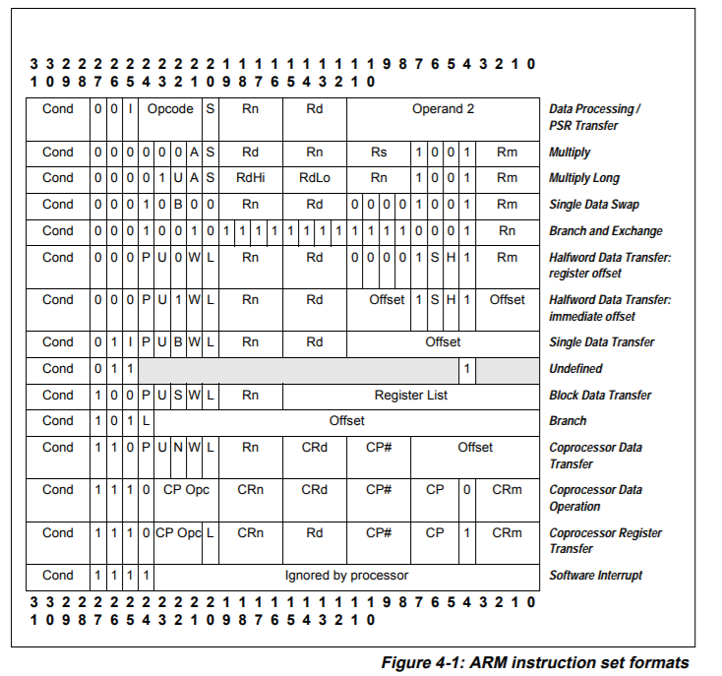
ISADesign:GeneralDesign
Bits are Precious
Long instructions are slow to load

Slide 4
ISADesign:GeneralDesign
Bits are Precious
Long instructions are slow to load

Slide 5
ISADesign:GeneralDesign
Bits are Precious
Long instructions are slow to load

Slide 6
ISADesign:GeneralDesign
Bits are Precious
Long instructions are slow to load
00

Slide 7
ISADesign:GeneralDesign
Bits are Precious
Long instructions are slow to load

Slide 8
ISADesign:GeneralDesign
Bits are Precious
Long instructions are slow to load

Slide 9
ISADesign:GeneralDesign
Bits are Precious
Long instructions are slow to load

Slide 10
ISADesign:GeneralDesign
Bits are Precious
Long instructions are slow to load

Slide 11
ISADesign:GeneralDesign
Bits are Precious
Long instructions are slow to load

Slide 12
ISADesign:GeneralDesign
Bits are Precious
Long instructions are slow to load
6 bits

Slide 13
ISADesign:GeneralDesign
Bits are Precious
Long instructions are slow to load

Slide 14
ISADesign:GeneralDesign
Bits are Precious
Long instructions are slow to load
Sample prefix code
00
01
100
101
1100
1101

Slide 15
ISADesign:GeneralDesign
Bits are Precious
Long instructions are slow to load
Sample prefix code
00
01
100
101
1100
1101
Precludes
other 00.. codes

Slide 16
ISADesign:GeneralDesign
Bits are Precious
Long instructions are slow to load
Sample prefix code
00
01
100
101
1100
1101
Precludes
other 00.. codes
Precludes
other 01.. codes

Slide 17
ISADesign:GeneralDesign
Bits are Precious
Long instructions are slow to load
Sample prefix code
00
01
100
101
1100
1101
Precludes
other 00.. codes
Precludes
other 01.. codes
Precludes
other 100.. codes
Precludes
other 101.. codes

Slide 18
ISADesign:GeneralDesign
Bits are Precious
Long instructions are slow to load
Sample prefix code
00
01
100
101
1100
1101
Precludes
other 00.. codes
Precludes
other 01.. codes
Precludes
other 100.. codes
Precludes
other 101.. codes

Slide 19
ISADesign:GeneralDesign
Bits are Precious
Long instructions are slow to load
Sample prefix code
00
01
100
101
1100
1101
111
Precludes
other 00.. codes
Precludes
other 01.. codes
Precludes
other 100.. codes
Precludes
other 101.. codes

Slide 20
ISADesign:GeneralDesign
Bits are Precious
Long instructions are slow to load
Sample prefix code
00
01
100
101
1100
1101
Precludes
other 00.. codes
Precludes
other 01.. codes
Precludes
other 100.. codes
Precludes
other 101.. codes

Slide 21
ISADesign:GeneralDesign
Bits are Precious
Long instructions are slow to load
Sample prefix code
00
01
100
101
1100
1101
1110
1111
Precludes
other 00.. codes
Precludes
other 01.. codes
Precludes
other 100.. codes
Precludes
other 101.. codes

Slide 22
ISADesign:GeneralDesign
Bits are Precious
Long instructions are slow to load
Sample prefix code
00
01
100
101
1100
1101
11100
11101
11110
11111
Precludes
other 00.. codes
Precludes
other 01.. codes
Precludes
other 100.. codes
Precludes
other 101.. codes

Slide 23
ISADesign:GeneralDesign
Bits are Precious
Sample prefix code
00
01
100
101
1100
1101
11100
11101
11110
11111
Long instructions are slow to load
Precludes
other 00.. codes
Precludes
other 01.. codes
Precludes
other 100.. codes
Precludes
other 101.. codes
Dividing up 4-bit patterns
0000 1000
0001 1001
0010 1010
0011 1011
0100 1100
0101 1101
0110 1110
0111 1111

Slide 24
ISADesign:GeneralDesign
Bits are Precious
Sample prefix code
00
01
100
101
1100
1101
11100
11101
11110
11111
Long instructions are slow to load
Precludes
other 00.. codes
Precludes
other 01.. codes
Precludes
other 100.. codes
Precludes
other 101.. codes
Dividing up 4-bit patterns
0000 1000
0001 1001
0010 1010
0011 1011
0100 1100
0101 1101
0110 1110
0111 1111

Slide 25
ISADesign:GeneralDesign
Bits are Precious
Sample prefix code
00
01
100
101
1100
1101
11100
11101
11110
11111
Long instructions are slow to load
Precludes
other 00.. codes
Precludes
other 01.. codes
Precludes
other 100.. codes
Precludes
other 101.. codes
Dividing up 4-bit patterns
0000 1000
0001 1001
0010 1010
0011 1011
0100 1100
0101 1101
0110 1110
0111 1111

Slide 26
ISADesign:GeneralDesign
Bits are Precious
Sample prefix code
00
01
100
101
1100
1101
11100
11101
11110
11111
Long instructions are slow to load
Precludes
other 00.. codes
Precludes
other 01.. codes
Precludes
other 100.. codes
Precludes
other 101.. codes
Dividing up 4-bit patterns
0000 1000
0001 1001
0010 1010
0011 1011
0100 1100
0101 1101
0110 1110
0111 1111

Slide 27
ISADesign:GeneralDesign
Bits are Precious
Sample prefix code
00
01
100
101
1100
1101
11100
11101
11110
11111
Long instructions are slow to load
Precludes
other 00.. codes
Precludes
other 01.. codes
Precludes
other 100.. codes
Precludes
other 101.. codes
Dividing up 4-bit patterns
0000 1000
0001 1001
0010 1010
0011 1011
0100 1100
0101 1101
0110 1110
0111 1111
A 101---------
B 101---------

Slide 28
ISADesign:GeneralDesign
Bits are Precious
Sample prefix code
00
01
100
101
1100
1101
11100
11101
11110
11111
Long instructions are slow to load
Precludes
other 00.. codes
Precludes
other 01.. codes
Precludes
other 100.. codes
Precludes
other 101.. codes
Dividing up 4-bit patterns
0000 1000
0001 1001
0010 1010
0011 1011
0100 1100
0101 1101
0110 1110
0111 1111
A 101---------
B 101---------

Slide 29
ISADesign:GeneralDesign
Bits are Precious
Sample prefix code
00
01
100
101
1100
1101
11100
11101
11110
11111
Long instructions are slow to load
Precludes
other 00.. codes
Precludes
other 01.. codes
Precludes
other 100.. codes
Precludes
other 101.. codes
Dividing up 4-bit patterns
0000 1000
0001 1001
0010 1010
0011 1011
0100 1100
0101 1101
0110 1110
0111 1111
A 101---------
B 101---------

Slide 30
ISADesign:GeneralDesign
Bits are Precious
Sample prefix code
00
01
100
101
1100
1101
11100
11101
11110
11111
Long instructions are slow to load
Precludes
other 00.. codes
Precludes
other 01.. codes
Precludes
other 100.. codes
Precludes
other 101.. codes
Dividing up 4-bit patterns
0000 1000
0001 1001
0010 1010
0011 1011
0100 1100
0101 1101
0110 1110
0111 1111
A 101---------
B 101---------

Slide 31
ISADesign:GeneralDesign
Bits are Precious
Sample prefix code
00
01
100
101
1100
1101
11100
11101
11110
11111
Long instructions are slow to load
Precludes
other 00.. codes
Precludes
other 01.. codes
Precludes
other 100.. codes
Precludes
other 101.. codes
Dividing up 4-bit patterns
0000 1000
0001 1001
0010 1010
0011 1011
0100 1100
0101 1101
0110 1110
0111 1111
A 101---------
B 101---------

Slide 32
ISADesign:GeneralDesign
Bits are Precious
Sample prefix code
00
01
100
101
1100
1101
11100
11101
11110
11111
Long instructions are slow to load
Precludes
other 00.. codes
Precludes
other 01.. codes
Precludes
other 100.. codes
Precludes
other 101.. codes
Dividing up 4-bit patterns
0000 1000
0001 1001
0010 1010
0011 1011
0100 1100
0101 1101
0110 1110
0111 1111
A 101---------
B 101---------

Slide 33
ISADesign:GeneralDesign
Bits are Precious
Sample prefix code
00
01
100
101
1100
1101
11100
11101
11110
11111
Long instructions are slow to load
Precludes
other 00.. codes
Precludes
other 01.. codes
Precludes
other 100.. codes
Precludes
other 101.. codes
Dividing up 4-bit patterns
0000 1000
0001 1001
0010 1010
0011 1011
0100 1100
0101 1101
0110 1110
0111 1111
0--------------------
10-------------------
110------------------
A 101---------
B 101---------

Slide 34
ISADesign:GeneralDesign
Bits are Precious
Sample prefix code
00
01
100
101
1100
1101
11100
11101
11110
11111
Long instructions are slow to load
Precludes
other 00.. codes
Precludes
other 01.. codes
Precludes
other 100.. codes
Precludes
other 101.. codes
Dividing up 4-bit patterns
0000 1000
0001 1001
0010 1010
0011 1011
0100 1100
0101 1101
0110 1110
0111 1111
0--------------------
10-------------------
110------------------
111------------------
A 101---------
B 101---------

